Slide 1
October 2021
Consumer Price Index
Released on 29th November 2021
Maldives Bureau of Statistics, Maldives

Slide 2
Inflation rate for October 2021
Monthly percentage change between September 2021 and October 2021
  Monthly inflation: +0.08%
    Monthly inflation excluding fish: +0.02%
Change from the corresponding month of the previous year (i.e. September 2021 to October 2021)
  Annual inflation (month on month): +0.14%

Slide 3
Overview of the CPI movements
CPI groups below are ordered in terms of their absolute significance to the change in All groups index points for the month.
The most significant price increase in this month were for;
Fruit (+3.17%),
Fish (+1.44%),
Fuels and lubricants for personal transport equipment (+2.94%) and
Security equipment and materials for the maintenance and repair of the dwelling (+0.76%).

Slide 4
Overview of the CPI movements
The most significant price decrease in this month were for;
Mobile communication services (-2.87%) and
Milk, other dairy products and eggs (-0.29%).

Slide 5
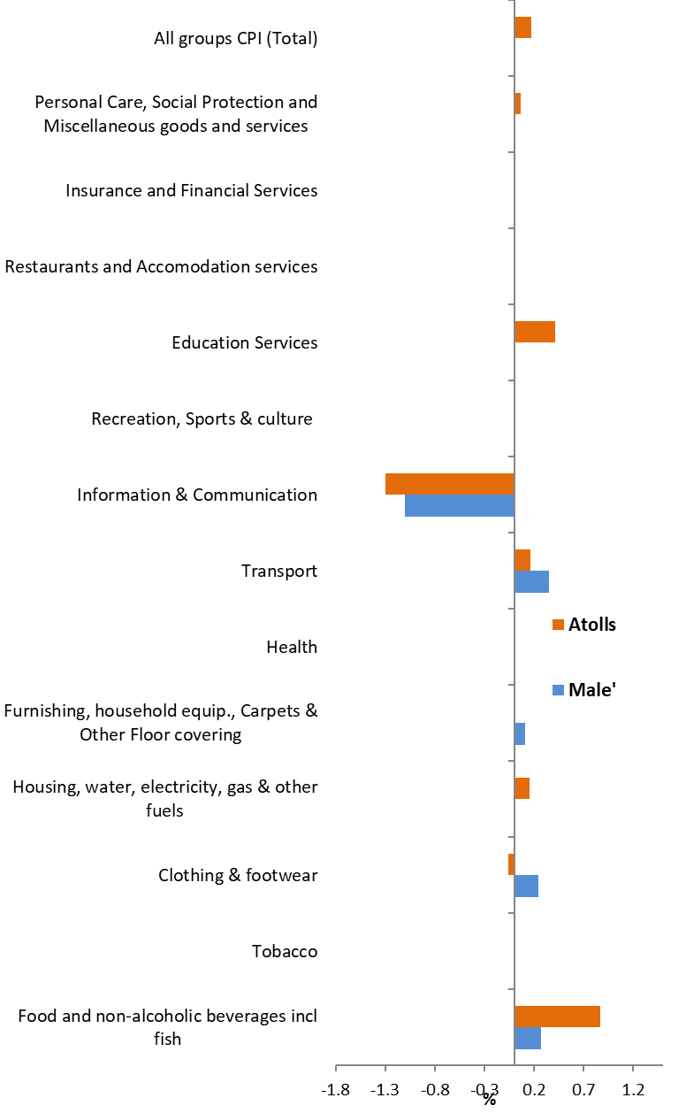
Monthly Inflation (September 2021 to October 2021)

Slide 6
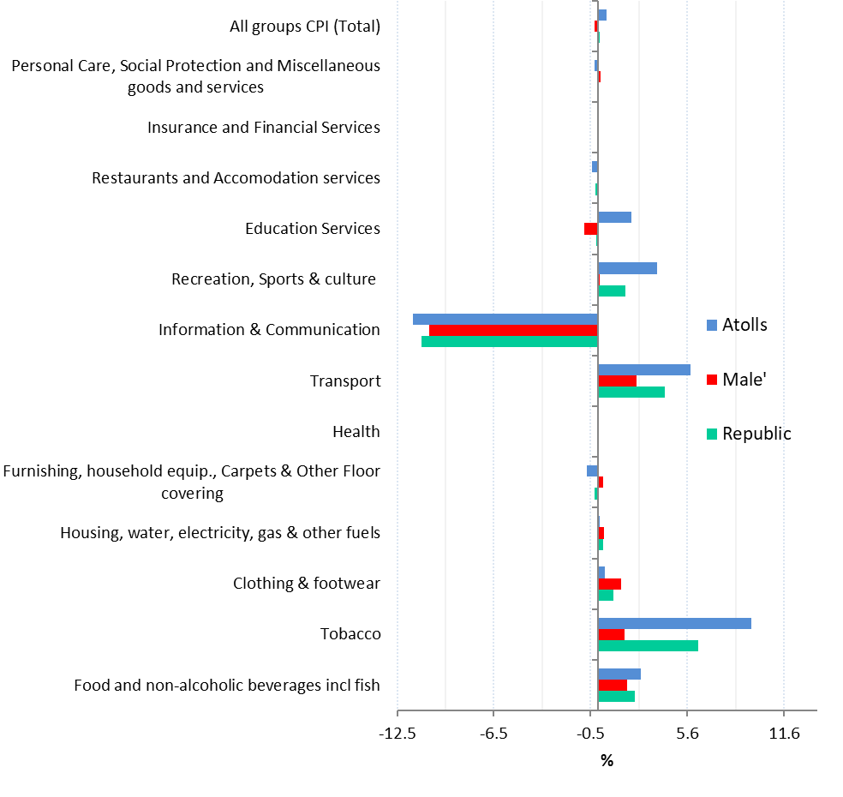
Month on Month Inflation (October 2020 to October 2021)2021)

Slide 7
Percentage change and change in index points used
  Movements in CPI from one period to the other period are expressed in index points as well as percentage changes.
  Information on points contribution and points contribution change (or points change) is of immense value when analyzing sources of price change

Slide 8
Contribution to monthly change
(September 2021 to October 2021)

Slide 9
Up-coming CPI releases
Monthly CPI is targeted to be released on the last Monday of the month at 10.00 am local time
Next release
  November CPI : 27th December 2021

Slide 10
Documents available
A guide to the Consumer Price Index, Maldives 2012
GUIDE
Index reference period is October 2019 = 100, weight reference period and Base period = December 2019
REVIEW
http://statisticsmaldives.gov.mv/nbs/wp-content/uploads/2019/10/GuideToCPI_Maldives2019-Publication.pdf

Slide 11
FOR MORE INFORMATION
Website: www.statisticsmaldives.gov.mv
National Accounts and Economic Statistics Section of the Maldives Bureau of Statistics can assist in understanding better the methodology of CPI and inflation.
Phone: 3008432/3008433
Email: info@stats.gov.mv

