Slide 1
February 2021
Consumer Price Index
Released on 29th march 2021
National Bureau of Statistics, Maldives

Slide 2
Inflation rate for February 2021
Monthly percentage change between January 2021 and February 2021
  Monthly inflation: -0.05%
    Monthly inflation excluding fish: -0.02%
Change from the corresponding month of the previous year (i.e. January 2021 to February 2021)
  Annual inflation (month on month): -0.95%

Slide 3
Overview of the CPI movements
CPI groups below are ordered in terms of their absolute significance to the change in All groups index points for the month.
The most significant price decrease in this month were for;
Mobile communication services (-4.62%),
Major household appliances, whether electric or not (-3.56%),
Fish (-0.78%), Actual rentals paid by tenants (-0.10%),
Security equipment and materials for the maintenance and repair of the dwelling (-0.74%),
Other information and communication services (-0.53%) and
Meat (-0.49%).

Slide 4
Overview of the CPI movements
The most significant price increase in this month were for;
Fruits (+4.06%),
Milk, other dairy products and eggs (+1.04%),
Photographic services (+5.64%),
Vegetables (+1.15%),
Fuels and lubricants for personal transport equipment (+3.49%),
Garments (+0.68%),
Bread and cereals (+0.29%),
Other food products (+0.74%) and
Tobacco (+0.27%).

Slide 5
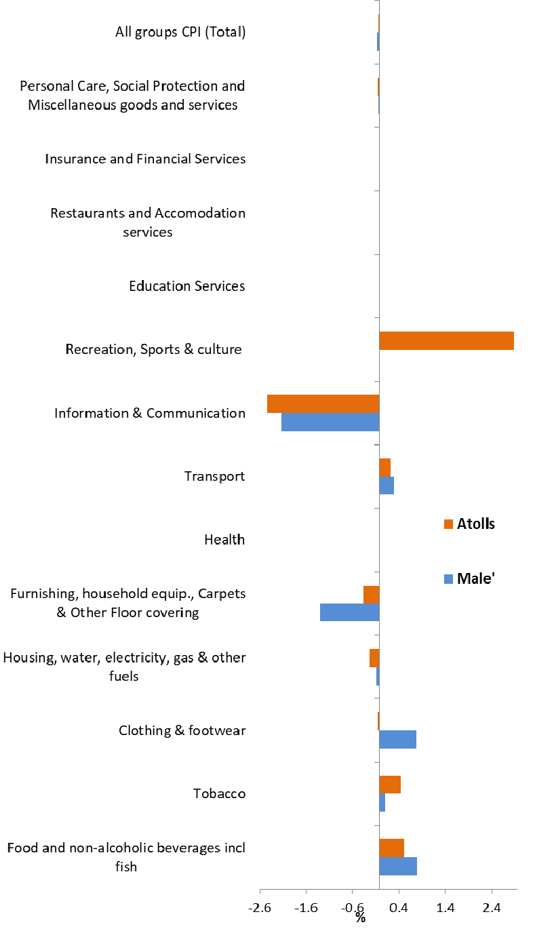
Monthly Inflation (January 2021 to February 2021)

Slide 6
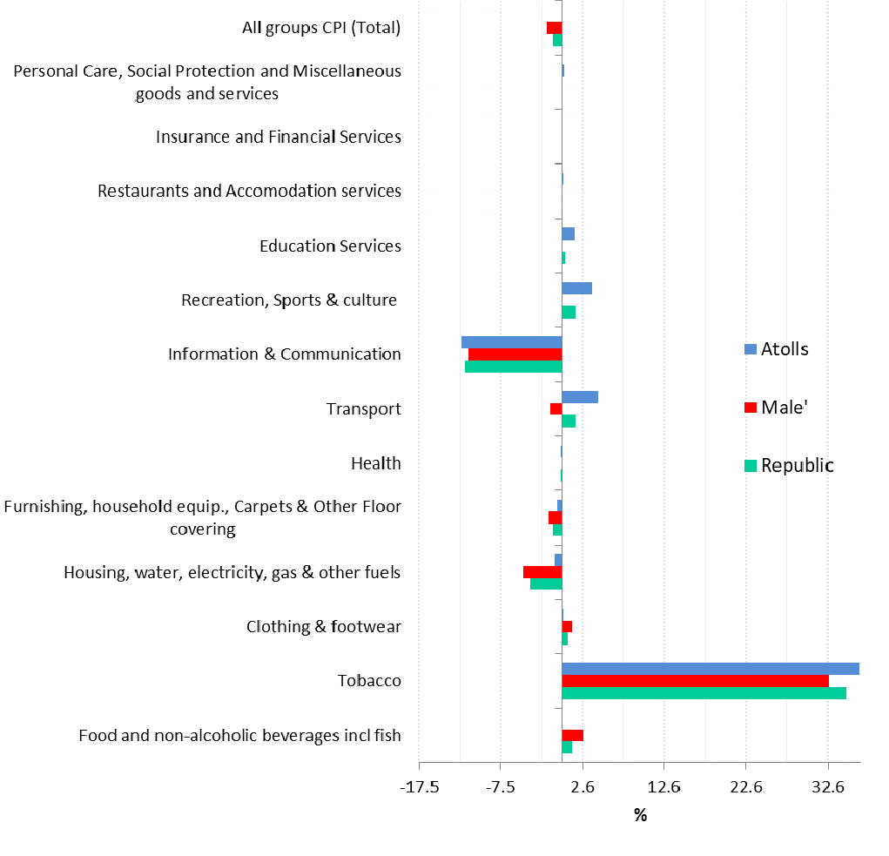
Month on Month Inflation (February 2020 to February 2021)

Slide 7
Percentage change and change in index points used
  Movements in CPI from one period to the other period are expressed in index points as well as percentage changes.
  Information on points contribution and points contribution change (or points change) is of immense value when analyzing sources of price change

Slide 8
Contribution to monthly change
(January 2021 to February 2021)

Slide 9
Up-coming CPI releases
Monthly CPI is targeted to be released on the last Monday of the month at 10.00 am local time
Next release
  March CPI : 26th April 2021

Slide 10
Documents available
A guide to the Consumer Price Index, Maldives 2012
GUIDE
Index reference period is September 2019 = 100, weight reference period and Base period = December 2019
REVIEW
http://statisticsmaldives.gov.mv/nbs/wp-content/uploads/2019/10/GuideToCPI_Maldives2019-Publication.pdf

Slide 11
FOR MORE INFORMATION
Website: www.statisticsmaldives.gov.mv
National Accounts and Economic Statistics Section of the National Bureau of Statistics can assist in understanding better the methodology of CPI and inflation.
Phone: 3008432/3008433
Email: info@stats.gov.mv

