Slide 1
JANUARY 2017
National Bureau of Statistics, Maldives
Consumer Price Index
Released on 27th Feb 2017

Slide 2
Inflation rate for January 2017
Monthly percentage change between Dec 2016 and Jan 2017
  Monthly inflation: +0.48%
    Monthly inflation excluding fish: +0.41%
Change from the corresponding month of the previous year (i.e. Jan 2016 to Jan 2017)
  Annual inflation (month on month): +2.91%

Slide 3
Overview of the CPI movements
CPI groups below are ordered in terms of their absolute significance to the change in All groups index points for the month
The most significant price rise recorded in this month were from;
  Secondary education (+6.25%)
  Electricity (+2.81%)
  Fish (+1.27%)
  Vegetables (+5.63%)
  Fruit (+3.77%)
  Fuels and lubricants (+5.64%)

Slide 4
Overview of the CPI movements
The most significant price fall in this month were for;
  Food products n.e.c (-1.37%),
  Pharmaceutical products (-1.01%),
  Major household appliances whether or not electrical (-0.45%)
  Non-durable household goods (-0.49%)
  Milk, cheese and egg (-0.10%)

Slide 5
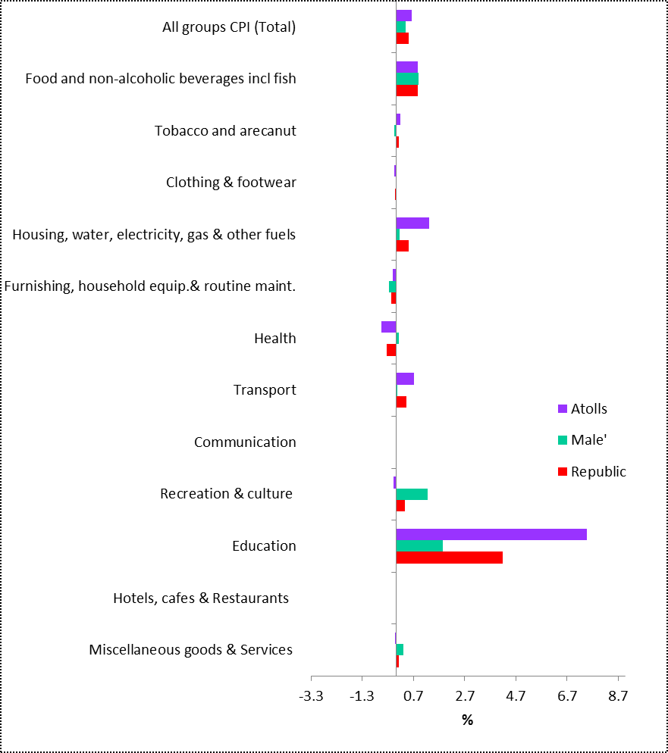
Monthly Inflation (Dec 2016 to Jan 2017)

Slide 6
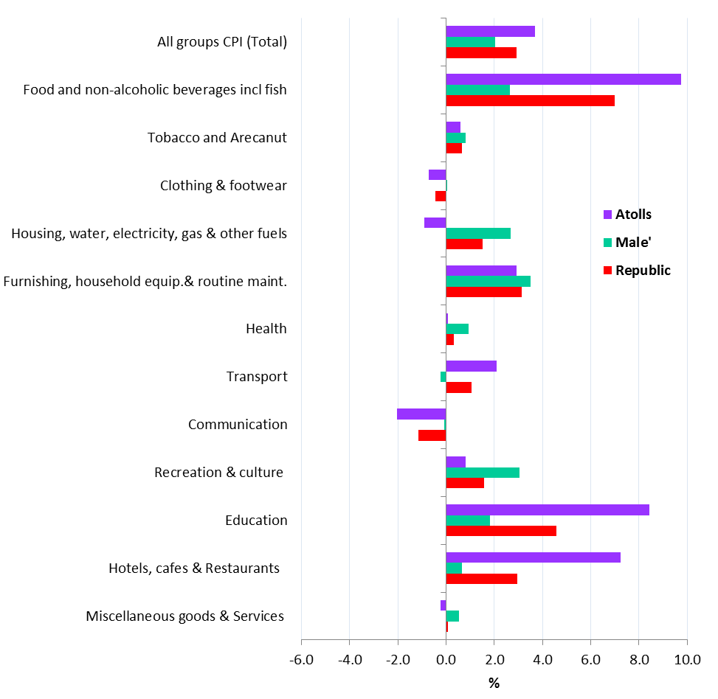
Month on Month Inflation (Jan 2016 to Jan 2017)

Slide 7
Percentage change and change in index points used
  Movements in CPI from one period to the other period are expressed in index points as well as percentage changes.
  Information on points contribution and points contribution change (or points change) is of immense value when analyzing sources of price change

Slide 8
Contribution to monthly change
(Dec 2016 to Jan 2017)

Slide 9
Up-coming CPI releases
Monthly CPI is targeted to be released on the last Monday of the month at 10.00 am local time
Next release
  Feb CPI : 27 March 2017

Slide 10
Documents available
A guide to the Consumer Price Index, Maldives 2012
GUIDE
Review of the Consumer Price Index, 2012 (Base Period June 2012=100)
REVIEW
www.statisticsmaldives.gov.mv/

Slide 11
FOR MORE INFORMATION
Internet www.statisticsmaldives.gov.mv
National Accounts and Economic Statistics Section of the National Bureau of Statistics can assist in understanding better the methodology of CPI and inflation.
Phone: 3008 433
Email: info@stats.gov.mv

